Slide 1

Energy Production Analysis Jan 2016 – Sep 2016
William Justice
Notes:
To change the image on this slide, select the picture and delete it. Then click the Pictures icon in the placeholder to insert your own image.

Slide 2
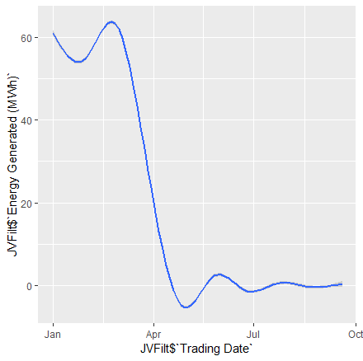
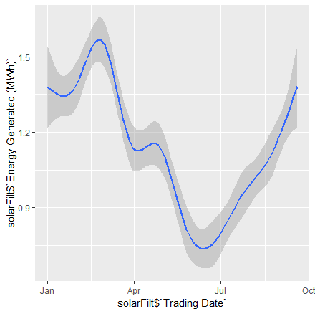
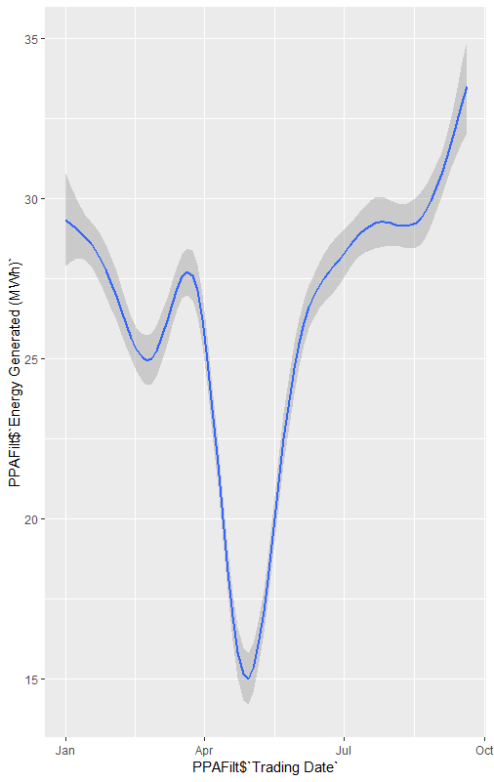
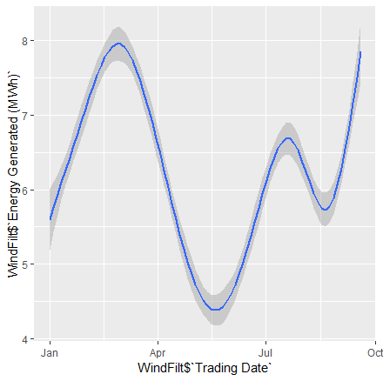
Compelling Trends
Joint Ventures
Trends of Joint Ventures, Solar, Purchase Power Agreements, and Wind energies show rates of a drastic downturn in energy generation.
Especially between the months of April and July.
This information leads to the hypothesis that inability to generate energy at a marketable price is significantly higher for the month of April 2016.
Solar
PPA
Wind

Slide 3
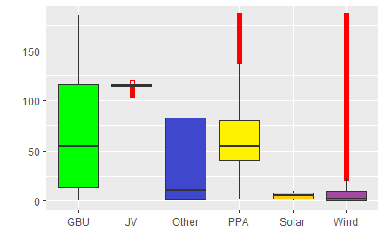
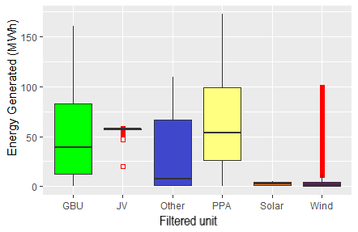
EOI average is higher regardless of unit
EOI (MW)
When the market creates conditions for generators to not bid due to price point infeasibility outliers generally remain constant between Energy Generated and EOI.

Slide 4
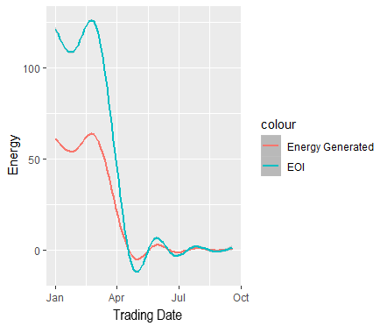
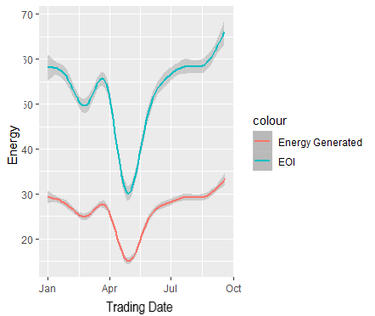
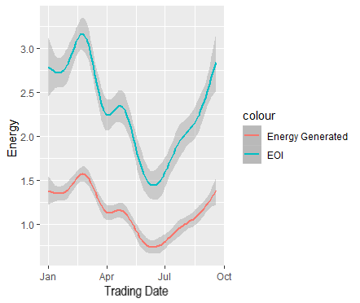
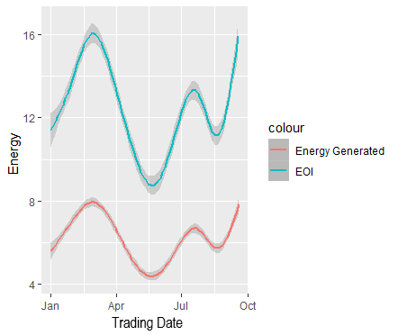
It is clear that there is a relation between infeasibility to produce energy and EOI.
*It should be noted that Energy generated is measured in (MWh) and EOI is measured in (MW). This is strictly for visual comparison and will be justified in the next slide
Joint Venture
PPA
Solar
Wind

Slide 5
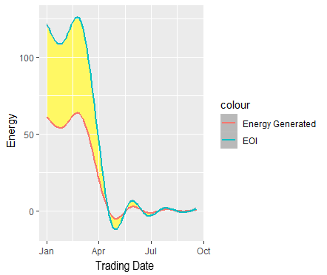
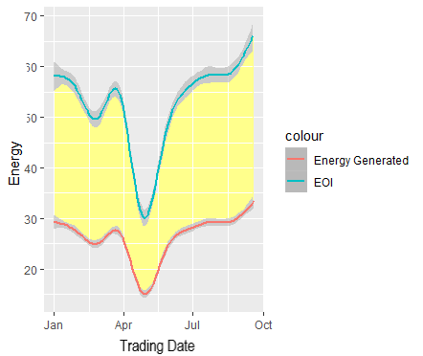
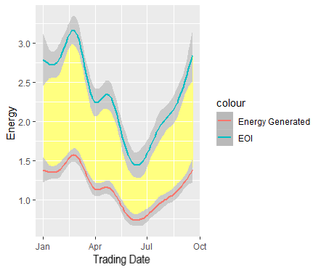
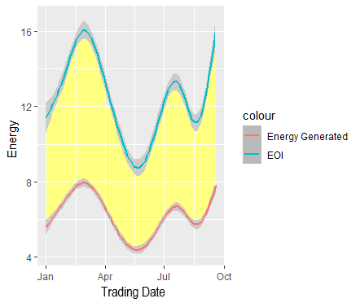
What does this mean in terms of difference between Energy Generated and EOI?
Joint Venture
PPA
Solar
Wind
Represents a difference of 19.504 (MW)
Difference of 51.871(MW)
Difference of 0.513(MW)
Difference of 0.518(MW)

Slide 6
April specifically showed an increase in the amount of non participation by producers due to economic cost factors.
There was an increase of 13% no bids across all platforms in the month of April.
Therefore we can conclude that the hypothesis was correct in stating that the downward trends are reflected by a larger majority of producers opting out of the market due to economic cost effectiveness.
From the data we can suggest that there was a major market shift across all energy producers that resulted in higher than anticipated price- points in the April time frame.

